Slide 1
Drug Monitoring in Hospitals
Jyoti Sharma
001643410

Slide 2
Problem Statement
The Pharmacy in hospitals does not have security in terms of its drug.
There is generally no proper record of the drugs in the pharmacy, even if it does, any kind of drug can be given to anyone which can be misused as well.

Slide 3
Solution
Electronically communicate the need of the medication/ prescription to both the Pharmacist and Patient.
The prescription status is not completed until the Patient confirms the completion.
The prescription is created by doctor only.
Employee activities should be captured in order to monitor them.

Slide 4
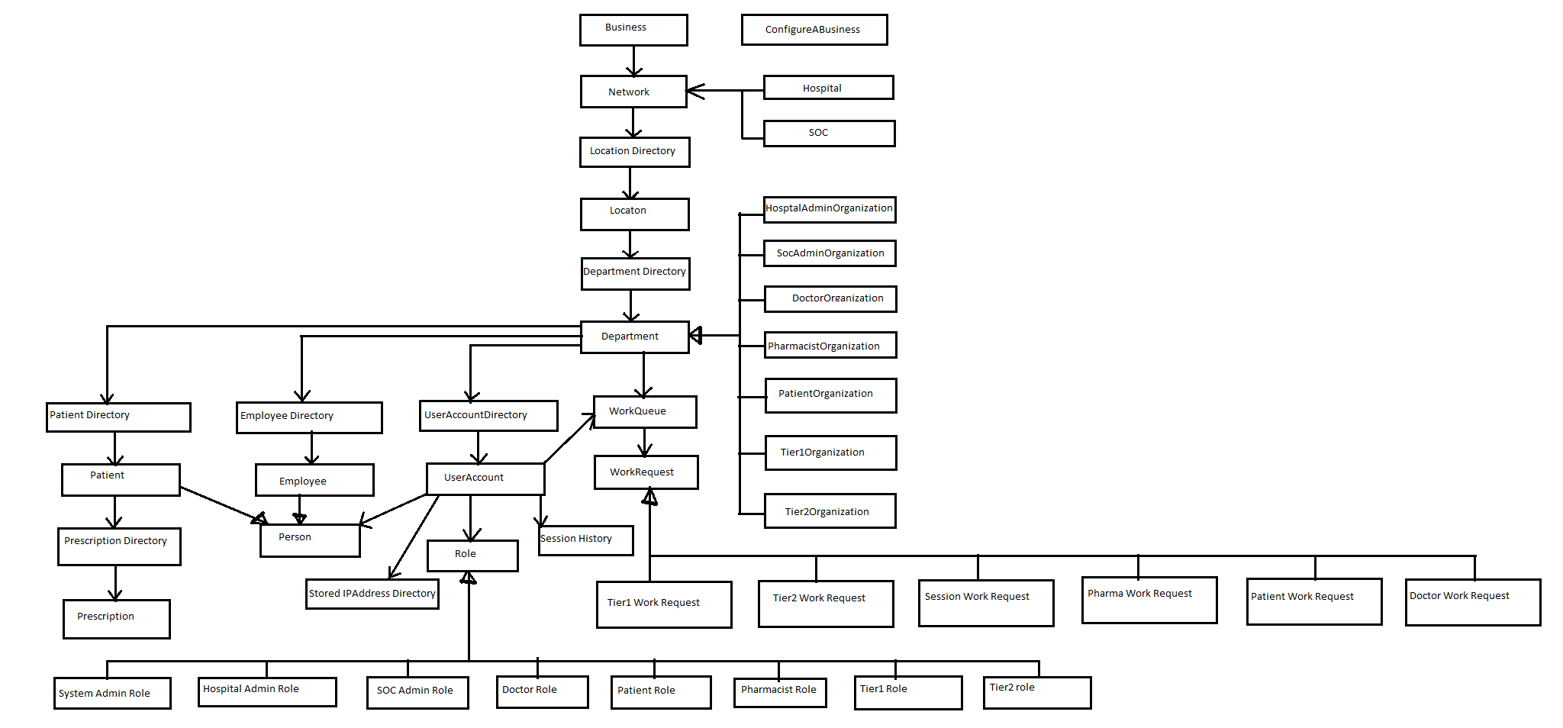
Object Model

Slide 5
Screen shots

Slide 6
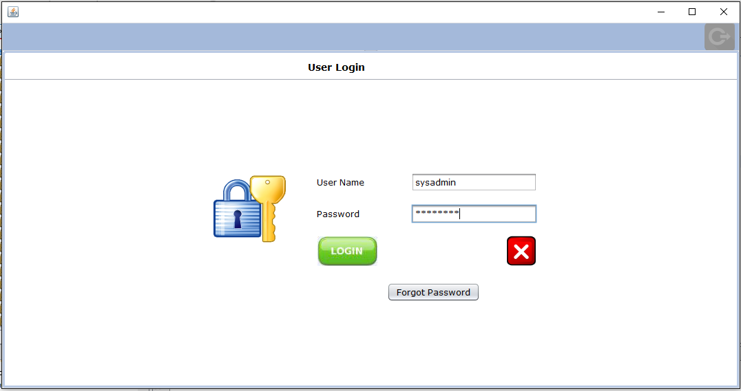

Slide 7
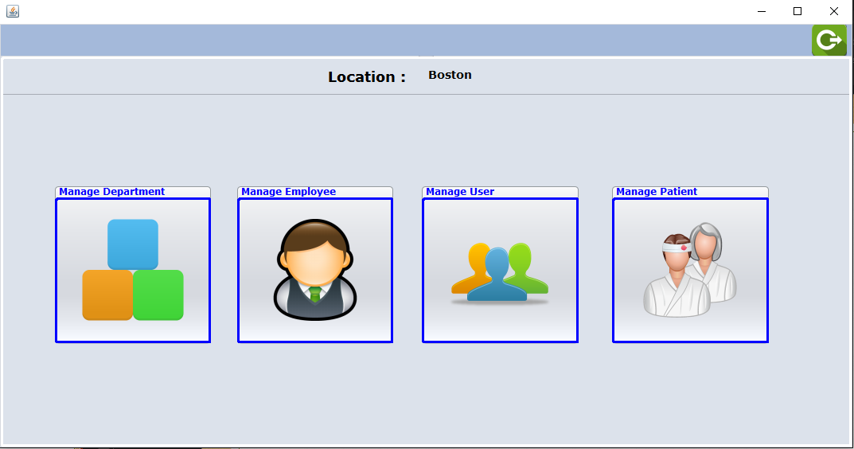

Slide 8
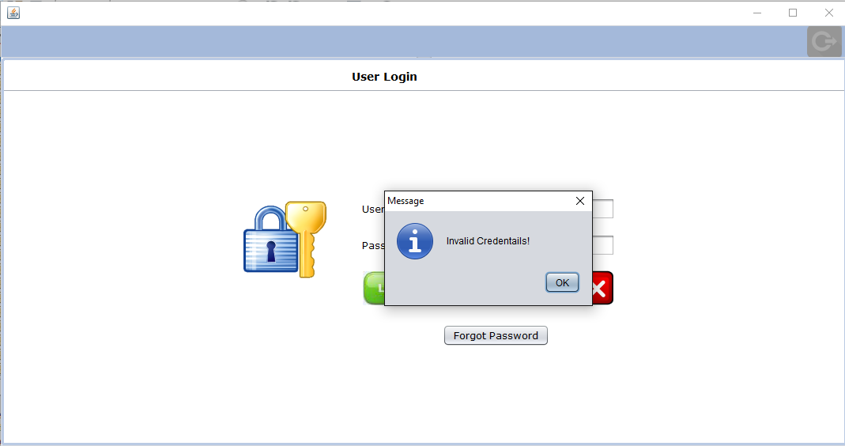
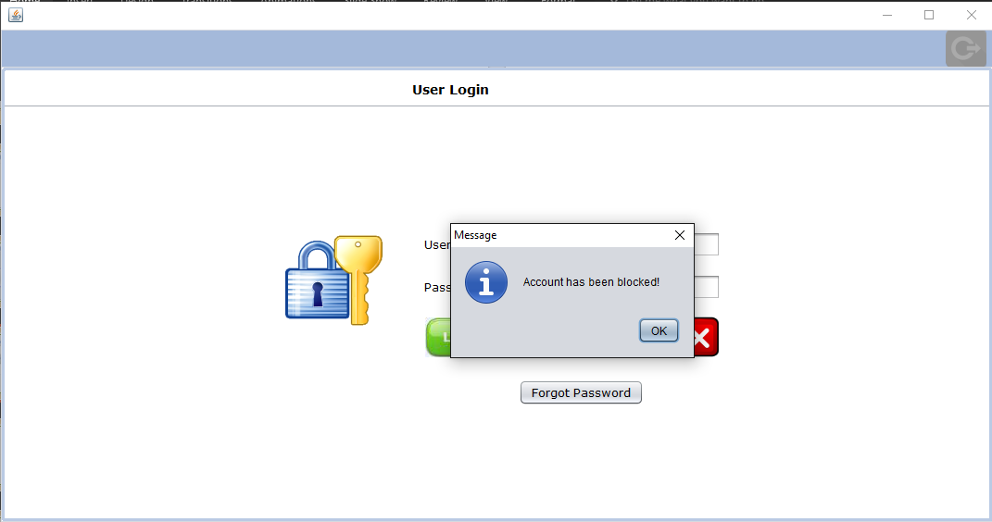

Slide 9
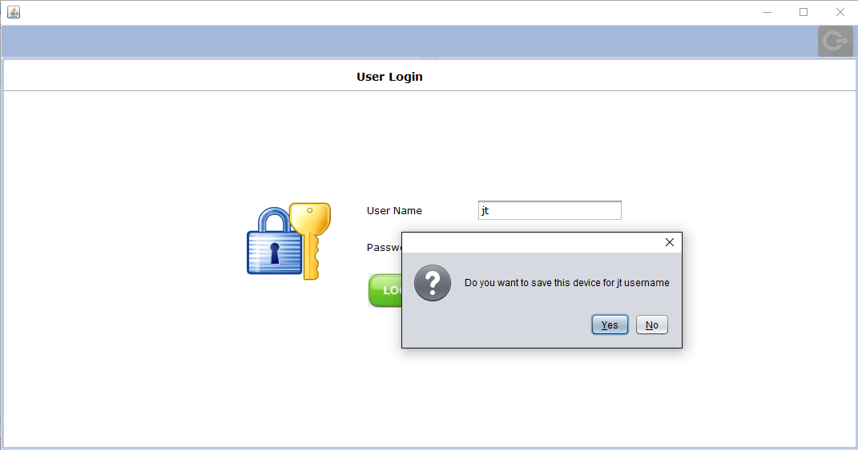
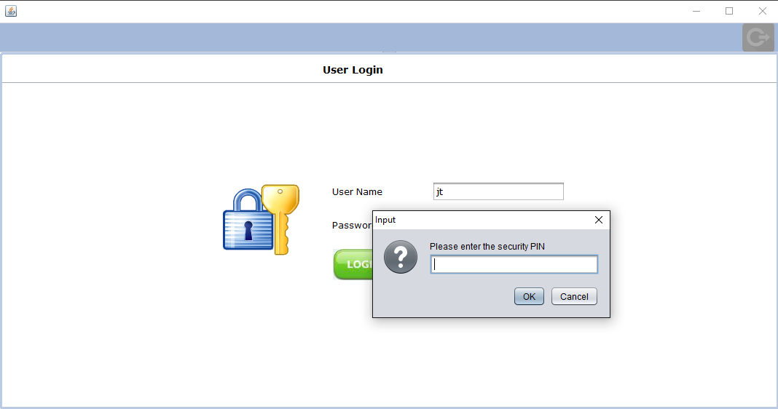
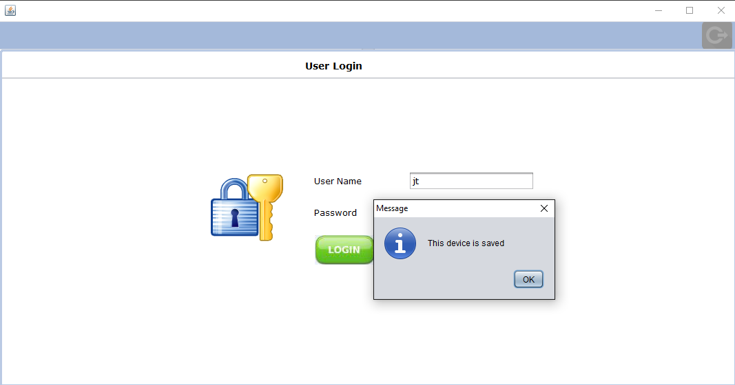

Slide 10
